Slide 1
THE BODY PARAGRAPH

Slide 2
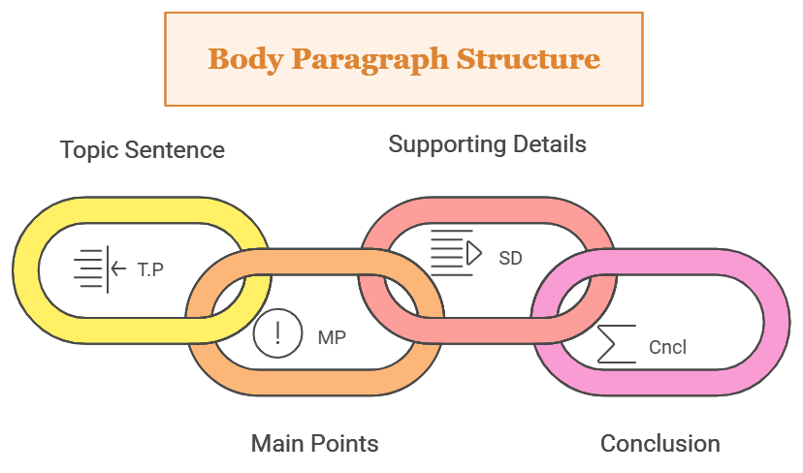
Body paragraphs are used in the main body of any piece of writing. They are the most important type of paragraphs as they contain all the information that the writer intends to convey.

Slide 3
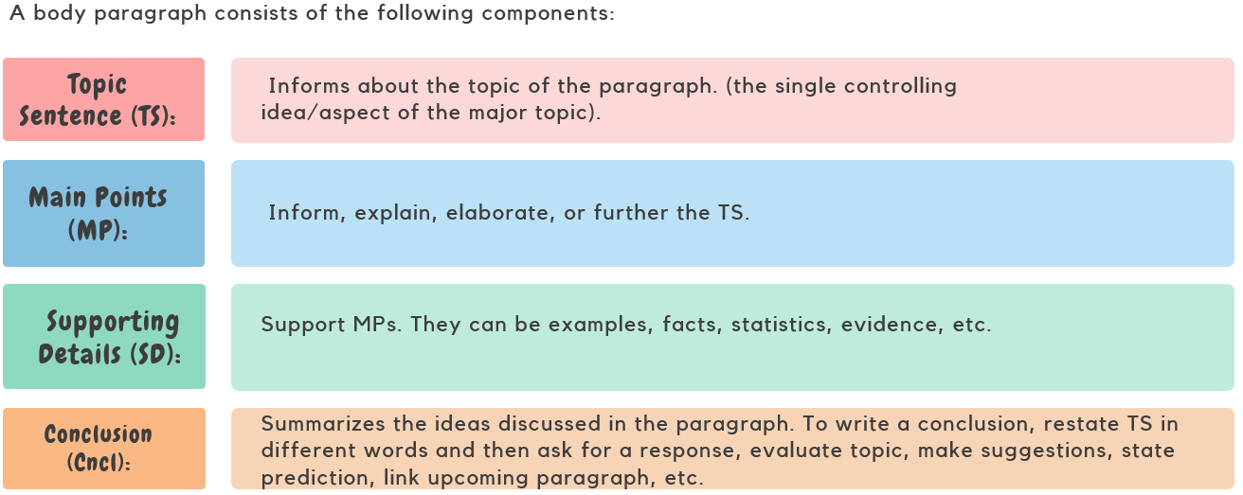

Slide 4
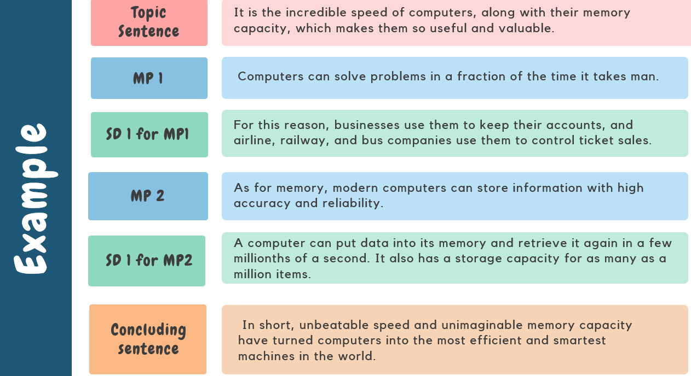

Slide 5
What is the controlling idea of this BP?
It is the incredible speed of computers, along with their memory capacity, which makes them so useful and valuable. Computers can solve problems in a fraction of the time it takes man. For this reason, businesses use them to keep their accounts, and airline, railway, and bus companies use them to control ticket sales. As for memory, modern computers can store information with high accuracy and reliability. A computer can put data into its memory and retrieve it again in a few millionths of a second. It also has a storage capacity for as many as a million items. In short, unbeatable speed and unimaginable memory capacity have turned computers into the most efficient and smartest machines in the world.

Slide 6
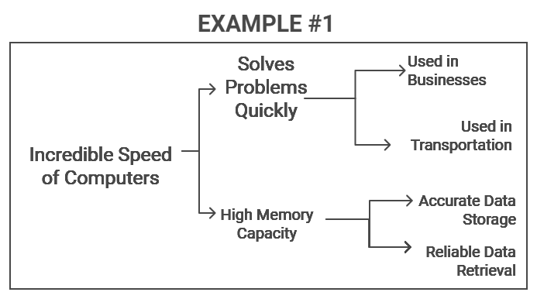

Slide 7
ACTIVITY ON PAGE # 101

Slide 8
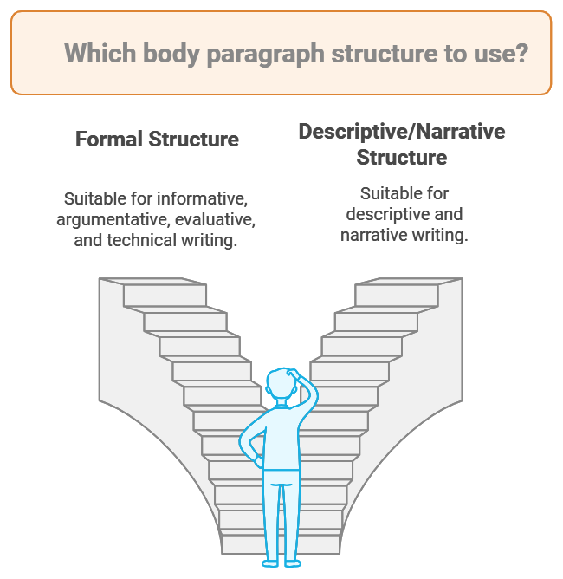

Slide 9
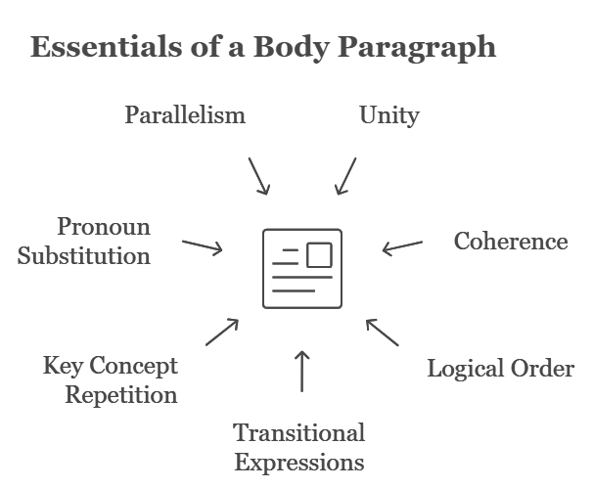

Slide 10
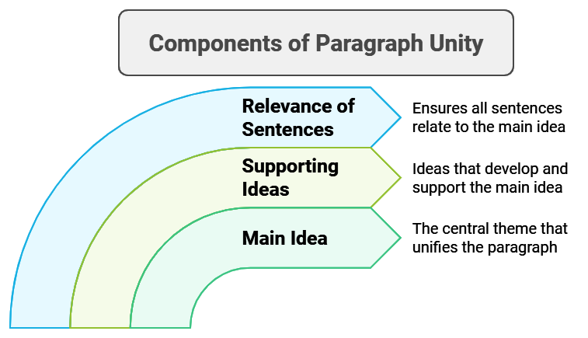

Slide 11
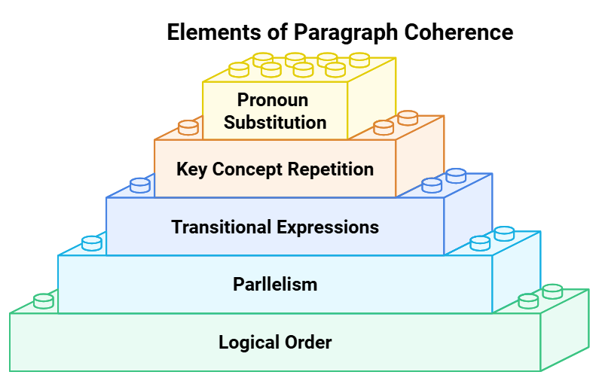

Slide 12
a) TIME ORDER:
The following paragraph develops the ideas chronologically (“chronos” means “time” and “logic” refers to “order”—so “chronologically” means “time order”).
Phil had an important dinner meeting with a client at 7 P.M. At 8 A.M., Phil took his car into the dealer for repairs. After an hour’s wait, the service technician explained the repairs necessary to fix the damage. By 10 A.M., Phil had talked to the service manager to get an estimate on the costs. Phil called his insurance agent at 10:30 A.M. to see if the bill was covered under his policy. Phil returned to the dealer’s at 6 P.M. and picked up his car. He made it to the restaurant on time for his dinner
with the client

Slide 13
b) SPACE ORDER (Direction):
Notice how the writer keeps you moving from the outside to the inside of the setting. You are moved from the trees, closer still to the bushes, still closer to the flowers, and even more closely to the petals, to the dew drops, and almost microscopically, to the little insects in the dew drops. It’s almost like being in a movie theater at the beginning of a movie, as the director sets the scene with a long-shot and all the while moving you closer and closer to some important aspect of the scene.
EXAMPLE:
The tall fir trees surrounded the open field. At the base of the trees, small shrubs ringed the green expanse like a floating fence. The field was dotted with blue “heal-all” flowers. On many of the flower petals, small beads of dew glistened in the morning sun. Tiny insects swam in the dew drops as if lounging in their own backyard pool.

Slide 14
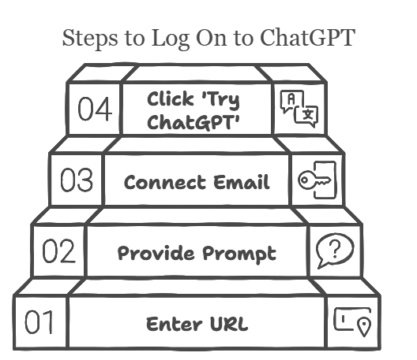
c) ORDER OF IDEAS:
If you were to explain to a friend how to logon to ChatGPT, you would not explain the process with ideas given in the following order:
1. Write https://openai.com/index/gpt-4o-and-more-tools-to-chatgpt-free/ in URL
2. Give prompt to the bot.
3. Click on ‘Try ChatGPT’.
4. Connect your email account with the bot by providing the existing email address and password.

Slide 15
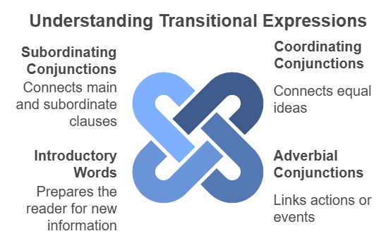
TRANSITIONAL EXPRESSIONS

Slide 16
PRACTICE:
The pilot took off from the airport in bright sunshine. The storm clouds on the horizon were thick and black. The small plane began to dip and shake. The winds from the approaching storm buffeted the small craft. The pilot struggled to keep the plane aloft. She called the airport tower for advice. She increased her speed. She headed the plane into the wind. The plane responded to the controls. She landed the plane safely at her destination. She called the tower personnel and thanked them for their help.
The pilot took off from the airport in bright sunshine; however, the storm clouds on the horizon were thick and black. Soon, the small plane began to dip and shake because the winds from the approaching storm buffeted the small craft, and the pilot struggled to keep the plane aloft. First, she called the airport tower for advice. Next, she increased her speed. Then, she headed the plane into the wind. As a result, the plane responded to the controls. Afterwards, she landed the plane safely at her destination. Finally, she called the tower personnel and thanked them for their help. Notice how this paragraph reads with much better rhythm and how the ideas are connected to show good.

Slide 17
Key Concept Repetition:
In longer works, because you are expressing so many ideas, it is vital that you keep the reader focused on the topic. One technique that will help you to accomplish this task is to repeat key concepts and words. Usually, the key concepts are expressed through your nouns: people, places, and things.
Example:
When trying to find a job, two tools are vital to the process if you hope to have any chance of success. First, complete a resume listing your education, work history, and personal attributes, such as hobbies and social and charitable organizations to which you belong. Along with your resume, write a letter of application. The letter of application, unlike the resume, summarizes your education, work history, hobbies, and social and charitable organizations and tailors them to the specific job for which you are applying. In this way, the resume and letter of application work together to give the prospective employer a more complete picture of you, your talents, and how they might fit with the
job and the company.

Slide 18
Substituting Pronouns for Key Nouns
Another method for achieving coherence is substituting pronouns for key nouns. The prefix pro- means “for,” as “standing in for” or “representing.” So, a pronoun is a word that can stand in for or represent a noun. Some commonly used pronouns are he, she, it, you, me, him, her, us, them, we, and they.
The children attended Patricia’s birthday party. While at the party, the children ate cake. The cake was chocolate with white icing. The children also ate ice cream. The ice cream was neopolitan, consisting of vanilla, chocolate, and strawberry flavors. The children also played games. The games included hide and seek, pin the tail of the donkey, and Twister. The children watched as Patricia opened her presents. The children also received a present for attending the party. The party was a great success. All the children had a wonderful time at the party.

Slide 19
Development of the Ideas
It means that every idea discussed in the paragraph should be adequately explained and supported through evidence and examples.
Example:
First of all, a friend must not tell lie. He must always tell me the truth and he must be honest because if there is honesty between two friends, their relationship will last until death. In addition to honesty, helping or being near a friend on a bad day is very important. Another point to consider is that he must criticize me is I make a mistake.

